Slide 1
POLICIES, BEST PRACTICES, AND RESOURCES FOR UNDOCUMENTED STUDENTS
Tanya Cabrera & Rigo Padilla Illinois DREAM Fund

Slide 2
Agenda
Mini Quiz
Why is this important?
Policies/Statutes/Legislation
Illinois’ Landscape
Who is an undocumented student?
Best Practices

Slide 3
Why does it matter?
Research has shown that the number one barrier for unauthorized students attending higher education is a lack of financial resources to cover the costs. As a result, most unauthorized students will begin at a community college but never finish a four year degree due to the inability to finance their education¹. Less than 10% of unauthorized high school graduates pursue college immediately after high school¹.

Slide 4
Policies, Legislation, Executive Orders
Plyler v. Doe – 1982
DREAM Act – 2001-Present
Deferred Action for Childhood Arrivals (DACA)
In-State Tuition (HB60) – 2003
Illinois DREAM Act – 2011

Slide 5
Plyler v. Doe (1982)
UNDER FEDERAL LAW, ALL STUDENTS – REGARDLESS OF CITIZENSHIP OR RESIDENCY – ARE ENTITLED TO AN EDUCATION The U.S. Supreme Court case Plyler v. Doe (1982) prohibited states from denying undocumented children a public K-12 education. According to the ruling, denying them that education would create a “lifetime of hardship” for undocumented children and a “permanent underclass” of individuals. However, nowadays, a high school diploma may not be sufficient.
Source: http://www.oyez.org/cases/1980-1989/1981/1981_80_1538

Slide 6
Federal Legislation
Development, Relief, and Education for Alien Minors (DREAM Act) was first proposed in 2001.
Pathway to citizenship if they complete 2-years of college or the military
Only a project, still not legislation
Comprehensive Immigration Reform (CIR)
Fast-track pathway to citizenship for those with DACA

Slide 7
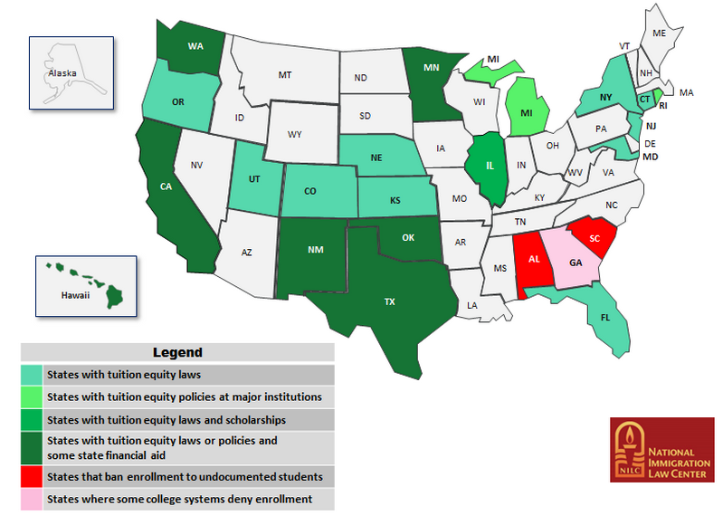
National Landscape

Slide 8
Deferred Action for Childhood Arrivals – (DACA)
Arrived in the United States before turning 16;
Have not left the United States since January 1, 2010 (starting in February 18, 2015)
Currently in school; graduated from high school/college or obtained a GED; or are honorably discharged veterans;
Have not been convicted of a felony, a significant misdemeanor, multiple misdemeanors, or otherwise pose a threat to national security or public safety;
Were under the age of 31 on June 15, 2012 (will be removed as of February 18, 2015); and at least 15 years old at the time of filing;

Slide 9
In-State Tuition – Illinois
The 2003 HB60 legislation (also known as Acevedo Bill) provides In-State Tuition to residents of the state of Illinois, so long as the student:
graduates from a high school within the state of Illinois;
attends school in Illinois for at least 3 years;
completes an affidavit stating that he/she will file an application to become a permanent resident of the US at the earliest opportunity to do so.

Slide 10
Undocumented Immigrants in Illinois
Illinois has set a goal to increase the percentage of the Illinois workforce who hold high quality college credentials to 60% by 2025. Of the estimated 100,000 undocumented immigrants enrolled in two and four year institutions in IL, 78% are juggling work, family and school. Nearly two-thirds have incomes below 200% federal poverty level.
The Obama administration has already deported more than 2 million immigrants since 2008. It is projected that he will deport 97,000 more immigrants. Within the ILDF online application in 2013-14 (Special Circumstance section) 37% of applicants stated a family member was in deportation proceedings or had already been deported.
An estimated 13,000 undocumented students in IL will graduate from high school in 2015. An estimated 7 % will financially be able to attend a community college. Financial assistance is said to be the greatest barrier for accessing higher education for this population. Federal Aid is not and cannot be awarded to undocumented immigrants due to policy and legislation.
Over 500 undocumented students in Illinois completed a FAFSA with their DACA social security number in 2013-14. Wrongfully accepting these funds is a federal offense and students place themselves in danger of deportation.

Slide 11
Illinois DREAM Act – Legislation
As stated in the appendix of the legislation of the Illinois Dream Act: Within the P-20 educational pipeline mandatory professional development on working with undocumented immigrants and families in Illinois. Institutional best practices in admissions, financial aid and tuition procedures, are to be made public knowledge to prospective applicants.

Slide 12
HB3528 – Public Funding at Universities
Currently, universities are legally not allowed to give any public funding to undocumented students
i.e. merit aid, tuition waivers, departmental scholarships
This legislation would give universities the ability to give financial assistance
Passed out of the Higher Learning Committee by a 10-5 vote

Slide 13
HB3534 – Professional Licensing
Amends the Department of Professional Regulation Law
If an individual meets all State requirements for licensures/certification & can legally work in the US, they cannot be denied on the basis of their immigration status.

Slide 14
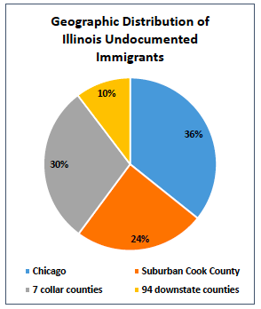
State of Illinois – Population Distribution
Illinois - Roughly 511,000 undocumented immigrants
Chicago - 183,000
Suburban Cook – 125,000
Collar Counties (DuPage, Grundy, Kane, Kendall, Lake, McHenry, Will) – 151,000
Downstate (94 counties) – 53,000

Slide 15
Age Distribution – Illinois
58,000 under the age of 18 in Illinois
19,000 under the age of 18 in Chicago

Slide 16
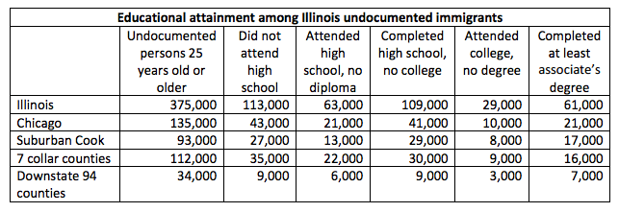
Quick Facts
41,000 have a high school diploma but never attended college
10,000 attended college but don’t have a degree
21,000 completed at least an associate’s degree

Slide 17
Mixed-Status Households

Slide 18
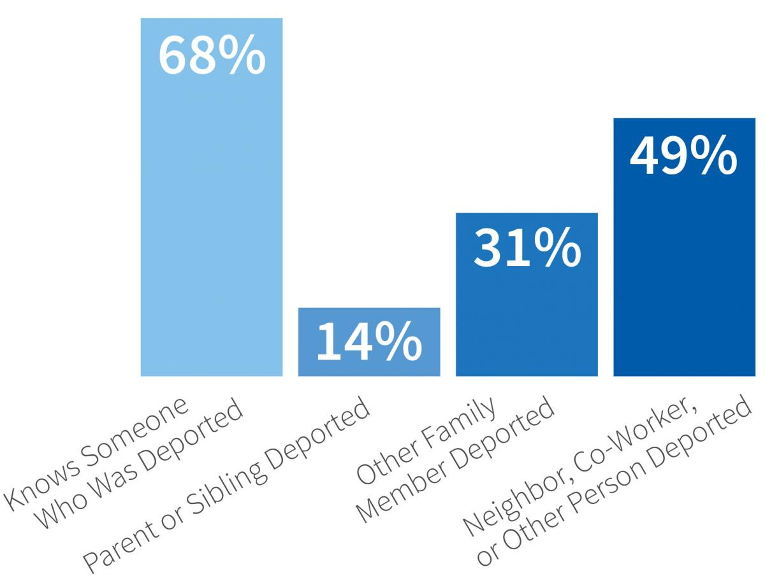
DACA Recipients’ Connections to Deported Individuals

Slide 19
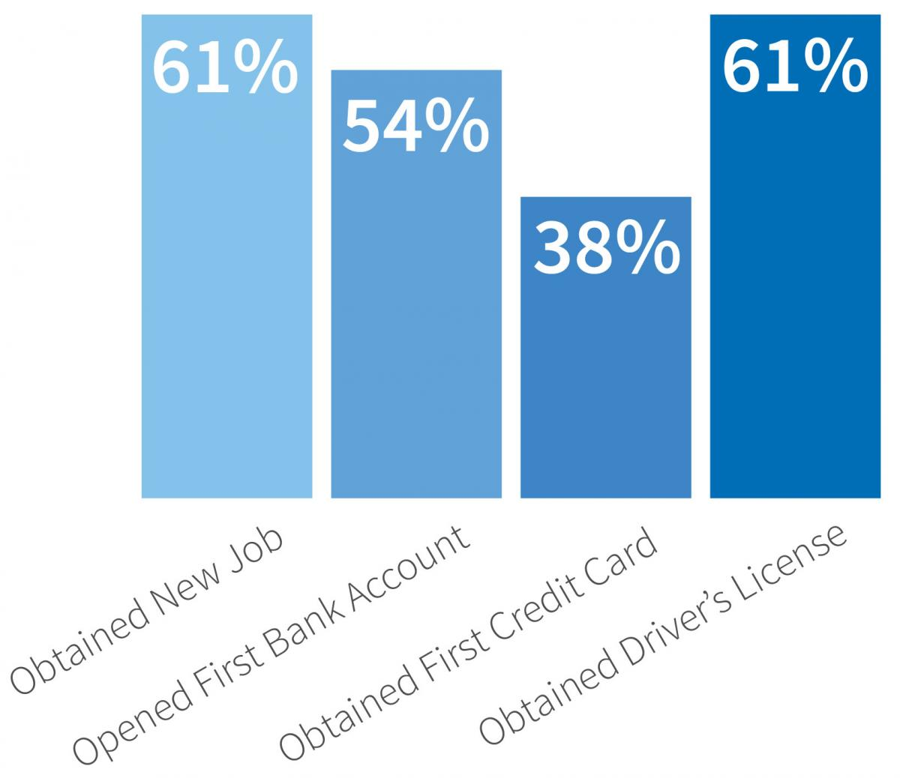
Economic and Social Incorporation Since Receiving DACA

Slide 20
Who are undocumented students?
The term “Undocumented Immigrant” refers to foreign-nationals who arrive in the United States one of two ways and reside in the U.S. long term without documentation.
The undocumented enter the country either:
Legally on a tourist, student or work visa, but overstay their visa after it expires.
Without any form of documentation or
without being inspected by an officer.
OR

Slide 21
Who are NOT Undocumented Students?
Lawful Permanent Residents
Those who are holders of a “green card”
Some VAWA recipients (Violence Against Women Act)
Those married to or children of an abusive U.S. citizen or permanent resident
Refugee & Asylum, Cuban-Haitian Entrant, Conditional Entrant People who have been or fear they will be persecuted due to race, religion, nationality, social group or political opinion
Victims of Human Trafficking
Those who are holders of a T-Visa
Temporary Protected Status (not eligible for FAFSA)
Immigrants from certain countries are granted this status if it is not safe for them to go back to their home country due to conflict

Slide 22
Mental Health & Other Challenges
The risk of having an anxiety disorder is even greater for undocumented youth due to uncertainty over their future, fear associated with their status and the social stigma about being undocumented.
Feeling stigmatized can also have a negative impact on self-esteem and may lead to depression.
Barriers to Mental Health Treatment:
Fear of deportation
Lack of health insurance and reluctance in seeking medical care for fear that undocumented status will be revealed
Limited affordable resources within the community

Slide 23
Dual Identity & Dealing With Stress
Undocumented students may not realize their status until they face rites of passage that require an SSN.
Many of them need to balance education and employment.
Many undocumented students experience high levels of stress regarding financial barriers and citizenship status. This stress, coupled with the fear of deportation, can lead to depression and anxiety.
Many undocumented students have adult responsibilities, which include working to support their families.
Please make students aware of school counselors, social workers, psychologists, free clinics, and crisis hotlines.

Slide 24
Best Practices & Internal Resources
University-Wide:
Language – Dropping the I-Word
Visuals – “I Support Undocumented Students” or “DREAMer Zone”
Education – Staying informed about laws/executive actions/policies that affect the students

Slide 25
Best Practices & Internal Resources
Admissions
Outreach efforts and institutional materials should include information on resources for undocumented students within the institution.
A how to guide to navigate the application and financial aid process:
Clarity on application process – Undocumented Students are not to be processed as international students (they do not posses Visas or able to process through SEVIS)
Financial aid – merit vs. need-based scholarships/additional institutional aid
Additional resources – Scholarship guide, etc.

Slide 26
Best Practices Continued
Financial Aid
Alternative forms to evaluate financial need and aid to be offered – NOT FAFSA!
What supporting documents are required to appeal for additional aid?
Identify a Financial Aid Liaison to directly work with these students and their families in understanding the families expected contribution (EFC).
Access to private scholarships offered as a continuing student

Slide 27
Two Year to Four Year Options
From 2-Year to 4-Year
Majority start at 2-year colleges
Transfer partnerships
Transfer credit guides
Advising students

Slide 28
Best Practices & Internal Resources
Academic Advising:
From 2-Year to 4-Year
CCC Star Scholarship
Part-Time vs. Full-Time
Financial Resources
Payment plans, institutional scholarships
Healthcare
All-Kids only available until age of 19

Slide 29
University Best Practices - Examples
Illinois Institute of Technology
Northern Illinois University
Aurora University
Loyola University – Chicago

Slide 30
Resources

Slide 31
Contact Information
Tanya Cabrera cabrera.tanya@gmail.com
(312) 919-9411
Rigo Padilla rigo.padilla@gmail.com illinoisdreamfund.org

Slide 32
A Special Thanks To:
Maria Bucio (La Casa Student Housing) & Luis Narvaez (CPS) for creating the original presentation that has since been adapted for this presentation.

Slide 33
Sources
Paral, R. (2014). “Illinois’ Undocumented Immigrant Population: Summary of Recent Research.”
Gonzales, R. (2013). Preliminary Findings from the National UnDACAmented Research Project

