Slide 1
go spelunk yourself
or how to achieve your hopes & dreams …

Slide 2
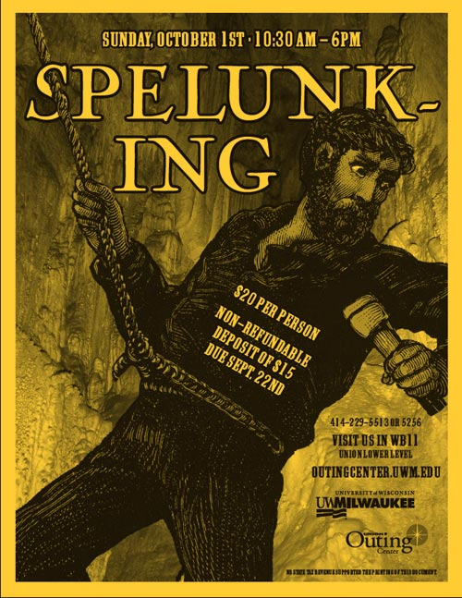
what does spelunking actually mean?

Slide 3
The real me?
not so much this
but more this

Slide 4
Maria is a scaredy cat – scared of left turns, epic vulnerability and speaking in front of you. She does it anyway, as kind of a sick and twisted form of exercise, because she believes the active and iterative breakthrough of fear makes people irrevocably attractive and makes moments celebrations.
My real bio

Slide 5
So let’s dig in.

Slide 6
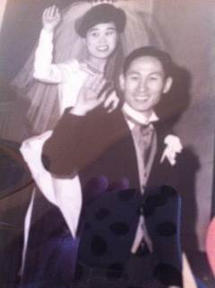
This is my mom & dad (kind of).

Slide 7
I am the product of a caregiver & an entrepreneur.

Slide 8
I went to catholic grade school & peed my pants.

Slide 9
I like some form of structure in my days.

Slide 10
A teacher believed in me.
Notes:
Key club
Terry jozwik
Nurturing a love of service
Believing in me and my leadership – that was my first presidency.
Service then became a theme of my life – in college in the Madison aids support network, after college with horizons for youth, today in my career and in my work.

Slide 11
Doing service didn’t really feel like work.

Slide 12
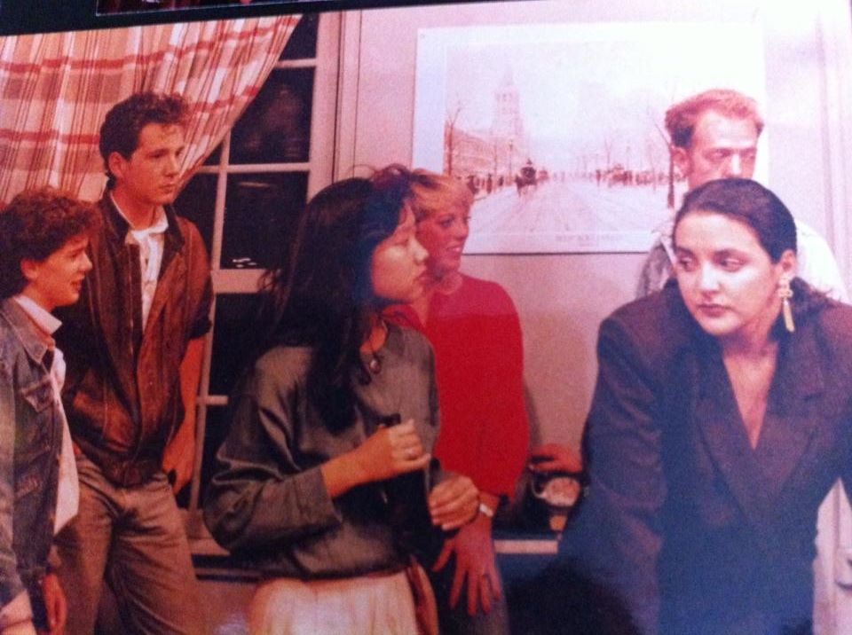
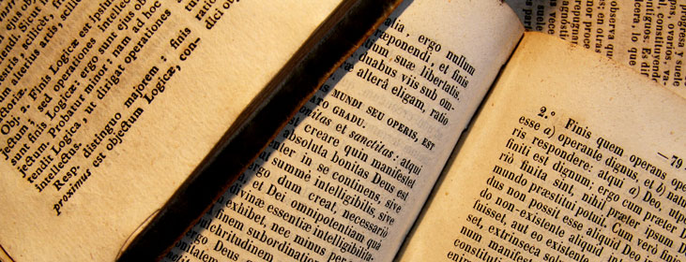
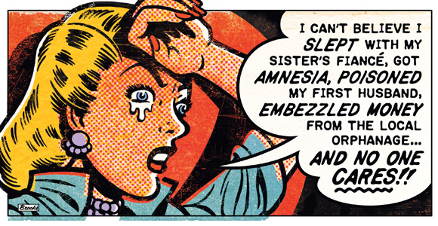
I kept trying things on.
I kept trying things on.
Notes:
Comparative literature
French
Soap opera
Even Korean name

Slide 13
And life picked a path for me.
Notes:
Tell them the story of making ends meet during school and needing to pay for your last year.
Moving your way up and ultimately running the IT division of a 400M firm without being a technologist by trade

Slide 14
I had the motts to move from the mailroom to the boardroom.

Slide 15
Now lemme explain the “kind of”.

Slide 16
I am in recovery.

Slide 17
9/11 happened & the whole world changed.
Notes:
For me.
For our firm.
Acquisition.
My vocation/

Slide 18
It’s never too late to find your vocation.

Slide 19
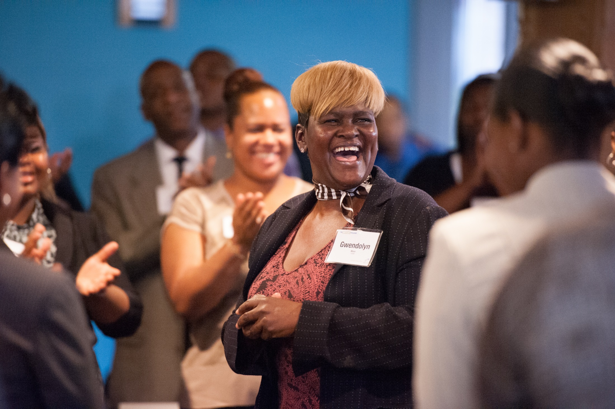
Check it out.

Slide 20
So you see, sometimes you have to go through to get to.

Slide 21
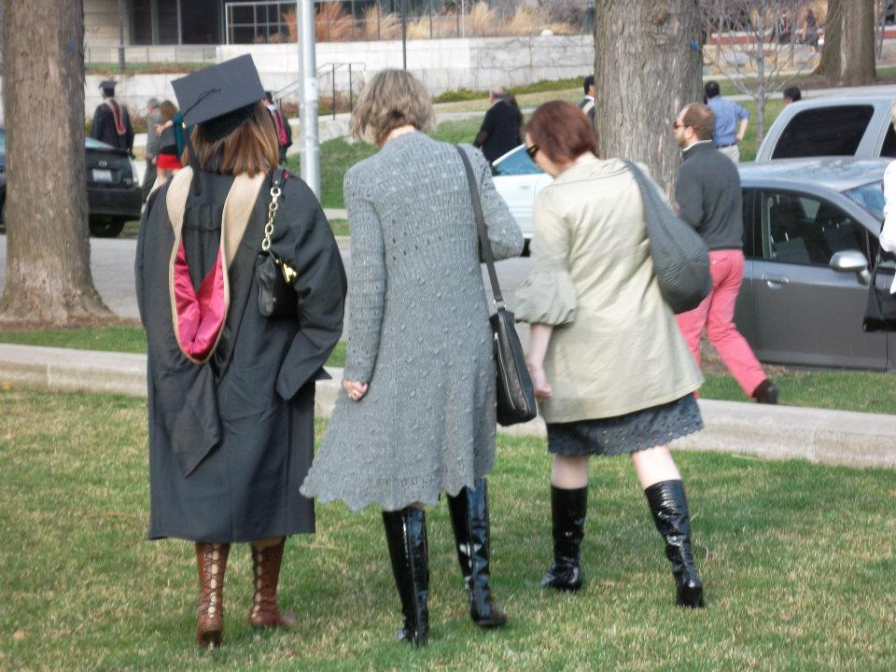
And once you get there, don’t relax.

Slide 22
Know where you came from. Listen to your body. Try things on. Do everything full-assed. Turn your baggage upside down. Don’t relax. And do you.
Key Lessons

Slide 23
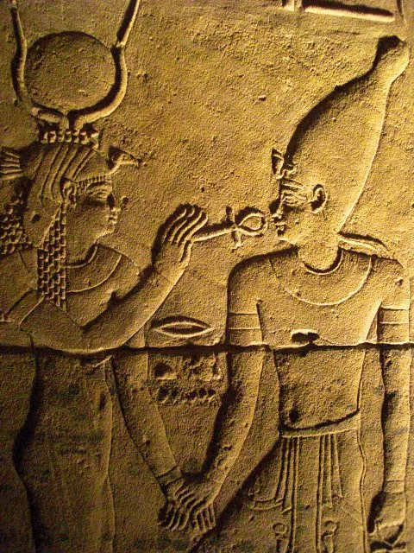
Live a story worth etching in stone.

Slide 24
Tell me what you discover along the way.
@maria_kim
mkim@thecaraprogram.org

