Slide 1
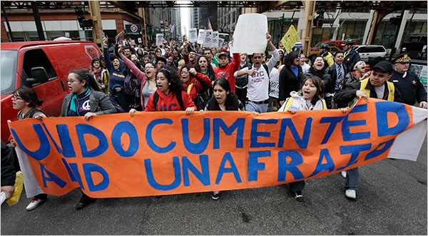
Accessing Higher Education
The Undocumented Student Pipeline

Slide 2
2013- 2014 Updates
DACA students are able to gain employment options. They are not however eligible for Federal Student Aid (FAFSA). This 2 yr work permit with S.S.# is solely for work purposes - not for scholarship, college applications and or FAFSA.
DACA Renewability will begin in 2014 - nothing has been finalized with regards to details - March 2014. Fees for the application may increase along with changes to eligibility.
17 States now provide in State Tuition to Undocumented/DACAmented students.
Teaching and Nursing certifications are open in IL. There is no federal that requires a social security to pursue a medical degree - 73% of the U.S. Physicians are immigrants.
First Undocumented Law student eligible to take bar in California.

Slide 3
Plyler v. Doe
(1982) A case in which the Supreme Court struck down a state statute denying funding for education to illegal immigrant children and simultaneously struck down a municipal school district's attempt to charge illegal immigrants an annual $1,000 tuition fee for each illegal immigrant student to compensate for the lost state funding.
The Court found that where states limit the rights afforded to people (specifically children) based on their status as immigrants, this limitation must be examined under an intermediate scrutiny standard to determine whether it furthers a substantial goal of the State.
The Illegal Immigration Reform and Immigrant Responsibility Act of 1996 have allowed some states to pass statutes that deny undocumented students eligibility for in-state tuition, scholarships, or even bar them from enrollment at public colleges and universities.

Slide 4
Applying to Institutions
There is NO FEDERAL LAW requiring school districts of employees of institutions of higher education to report undocumented students to immigration authorities. Doing so would violate FERPA (Family Educational Rights & Privacy Act) if information in a student's educational records is disclosed without consent.
Undocumented Students are NOT INTERNATIONAL STUDENTS. Do not possess a VISA and are ineligible to complete a FAFSA. DACA students should NOT use their DACA S.S.# on college applications or to complete a FAFSA.

Slide 5
Public Institutions
Due to the IIRIR Act, public institutions are unable to offer Merit or Need Based Aid to undocumented immigrants. Some institutions have a don’t ask - don’t tell policy. This means if you do not disclose your status they may be eligible to offer you merit based aid.
Understand that Tuition is only one piece of attending and that additional costs, such as: Institutional Fees, Labs, Medical Insurance, Books and Transportation are not included in tuition. These fees would also needed to be added on to your tuition expenses.
AFFIDAVIT: Written version of a sworn statement that is utilized to be considered for in-state tuition (HB-60).This form indicates a promise to legalize their immigration status as soon as they are eligible. Signed by a notary public - someone within your high school/institution is a notary public.
IACAC: Illinois Association for College Admission Counseling - A 2/4 yr guide for undocumented students in IL/outside of IL. http://www.iacac.org/undocumented/

Slide 6
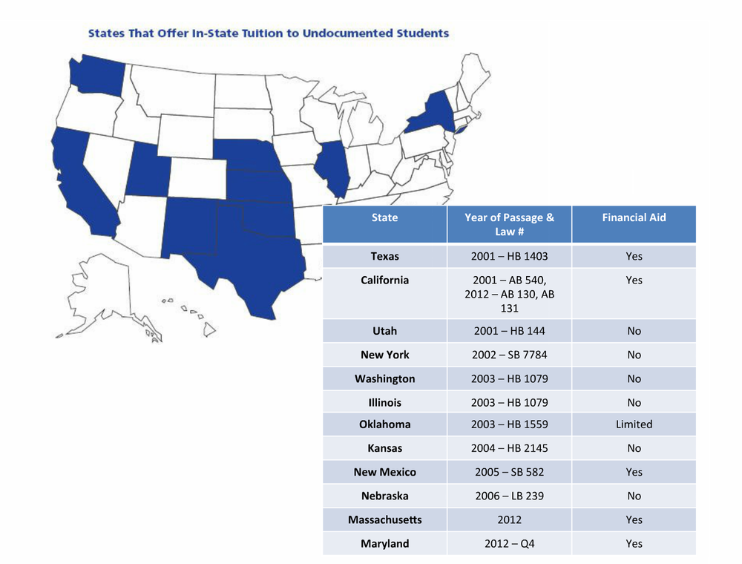

Slide 7
Illinois Dream Act
2014-15 On-line application will go live December 2013. Deadline March 1, 2014.
GPA: 2.5 with 2 letters of recommendation (non family member).
Open to undocumented immigrants who are ineligible to complete a FAFSA and DACA students.
Recipient must attended an accredited 2/4 year institution in or outside of IL. No funds will be distributed to for profit institutions.
2 Essays: (1)Your personal story on being an undocumented student. (2) Special Circumstance: is there anything else you would like the selection committee to be aware of.
February Higher Educational Access Panel - Illinois Latino Family Commission, IRS, IL Certification Board.
March 2014: Undocumented Student College Fair - MXC.
www.illinoisdreamfund.org

Slide 8
Questions??
Tanya Cabrera
(312) 919-9411 tcabrera@iit.edu
Associate Director
Minority Outreach & Undocumented Student Initiatives
Vice Provost - IIT

