Slide 1
Networking 101
Gabriel Razo Director Career Planning & Placement Harold Washington College grazo7@ccc.edu 312-553-3216 | Allison Zures Executive Director Career Planning & Placement CCC District Office azures@ccc.edu 312-553-2517
Harold Washington Career Planning & Placement Office
Room 1140
(312) 553-3000
Monday-Thursday: 9:00 a.m. - 5:00 p.m. Friday: Closed Appointments: Monday - Thursday 9:30 a.m. - 11:30 a.m. & 2:00 p.m. - 4:00 p.m.

Slide 2
Networking & Online Professionalism
Objectives
At the end of today’s session, you should be able to:
Understand how to conduct oneself professionally online
Understand how to network, both online and in-person
Develop an Elevator Speech and successfully present oneself to others
Understand how to work Job Fairs

Slide 3
Online Networking Principles
More Than a Job Search
Identify opportunities to grow.
Volunteer roles/ interest groups.
Find roles faster.
Build Your Online Brand
Establish your skills and credibility.
Show off your successes.
Make recruiters come to you.
Be a Resource for Others
Make it easy for people to ask you for help.
Build a pool of people you can ask for favors when you need them.
Identify the People Who Can Help
Find the experts fast.
Leverage your entire network’s expertise.
Don’t Be “That Guy”
Employers will find your profile.
The Internet is forever.

Slide 4
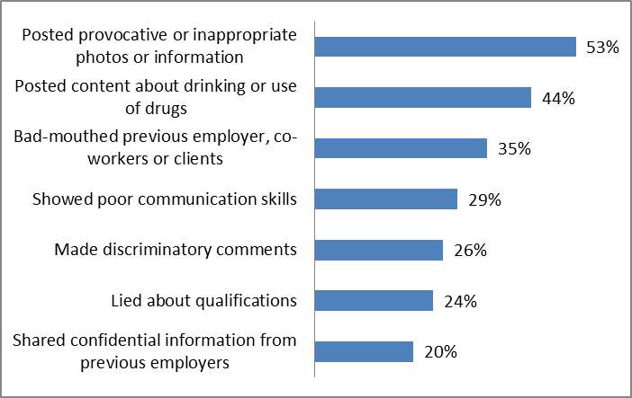
What an Employer Might Find…
In a 2009 CareerBuilder.com survey, 45% of companies reported using social networking profiles to screen candidates. Top reasons employers cited for not hiring a candidate…
“CareerBuilder.com”, last updated 10 June 2009, http://www.careerbuilder.com/Article/CB-1337-Interview-Tips-More-Employers-Screening-Candidates-via-Social-Networking-Sites/.

Slide 5
Censor, Censor, Censor!
Review your social network settings – remember, the Internet is forever!
Delete accounts or hide them from public view
Appear well-rounded and intelligent
Be mindful of content that is exposed to the public – that includes pictures!
Social Media influences a potential contact’s perception of you…and whether or not they want to remain connected!

Slide 6
Facebook – For Good or Evil
True Story: A Math and Science teacher lost her job because she wrote on her Facebook wall: “The people are arrogant and snobby.” She added: “I’m so not looking forward to another year at [school] …Kids…they are germ bags!”
Acceptable Wall Post | Wall Post to Avoid
Today my boss told me “he couldn’t have done the project without me.” It’s going to be a good week. | Hey, I’m going to put you down as a job reference. If you get a call, just say you were my boss.
10K this weekend…super nervous, but feeling ready. Wish me luck. | OMG, just got pulled over again for speeding—third time this month!
Pretty much all moved in to our new office. Should be able to finish unpacking tomorrow. Excited! | I now have a longer commute thanks to my office moving AGAIN. Why can’t they stay put!

Slide 7
Facebook – For Good or Evil
Exercise: Acceptable or Not?
There can be a fine line between what is ok to post and what can make an employer say hmmm…
“Glad I’m not working for MicroPlace any more. Super excited about my new job with ComputerSoft…I think I’m going to love it there.”
Notes:
EXERCISE: Have students identify if the post is acceptable or not, and explain why or why not.

Slide 8
Facebook – For Good or Evil
Exercise: Acceptable or Not?
There can be a fine line between what is ok to post and what can make an employer say hmmm…
“Glad I’m not working for MicroPlace any more. Super excited about my new job with ComputerSoft…I think I’m going to love it there.”
x
Although you’re giving praise to your new employer, you never want to speak poorly of a previous employer.
Notes:
EXERCISE: Have students identify if the post is acceptable or not, and explain why or why not.

Slide 9
Facebook – For Good or Evil
Exercise: Acceptable or Not?
There can be a fine line between what is ok to post and what can make an employer say hmmm…
“Leaving work early today. Really need to get stuff done around the house.”

Slide 10
Facebook – For Good or Evil
Exercise: Acceptable or Not?
There can be a fine line between what is ok to post and what can make an employer say hmmm…
“Leaving work early today. Really need to get stuff done around the house.”

Stating that you’re leaving work early is ok, assuming your boss knows and it’s approved.

Slide 11
Facebook – For Good or Evil
Exercise: Acceptable or Not?
There can be a fine line between what is ok to post and what can make an employer say hmmm…
“Another fight with the boyfriend. I’m so tired of men. I’m in desperate need of a bottle of wine and a night in with the girls.”

Slide 12
Facebook – For Good or Evil
Exercise: Acceptable or Not?
There can be a fine line between what is ok to post and what can make an employer say hmmm…
“Another fight with the boyfriend. I’m so tired of men. I’m in desperate need of a bottle of wine and a night in with the girls.”
x
Although not related to work, it’s advised to keep personal problems off the Internet. This could also be seen as discriminatory, even if it was meant to be sarcastic.

Slide 13
Facebook – For Good or Evil
Exercise: Acceptable or Not?
There can be a fine line between what is ok to post and what can make an employer say hmmm…
“Meeting up with John for drinks later.”

Slide 14
Facebook – For Good or Evil
Exercise: Acceptable or Not?
There can be a fine line between what is ok to post and what can make an employer say hmmm…
“Meeting up with John for drinks later.”

It’s okay to mention what you do in your personal time as long as you’re not giving details/photos that are inappropriate, or cause your employer to question your judgment.

Slide 15
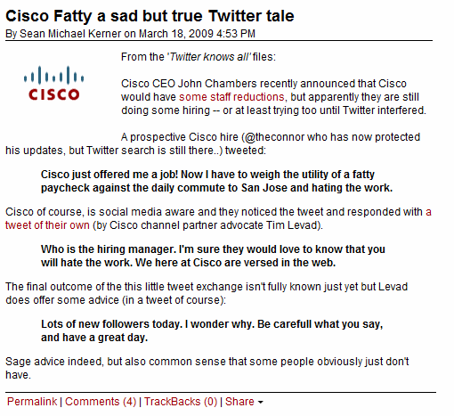
Twitter
Twitter is a “micro-blogging” tool.
Get notified of open positions, corporate news and events.
Stay up-to-date with trending topics.
Keep your followers up-to-date of your achievements.
Same rules apply as Facebook.
Don’t make inappropriate tweets.
Notes:
Source for article: http://blog.Internetnews.com/skerner/2009/03/cisco-fatty-a-sad-but-true-twi.html

Slide 16
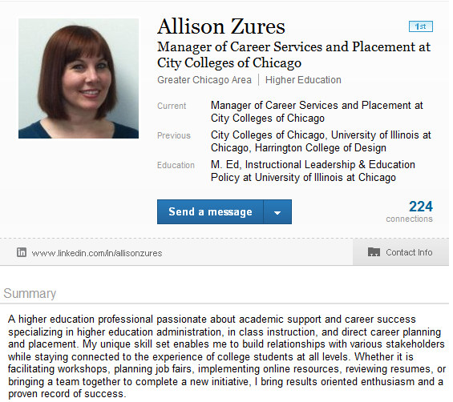
LinkedIn
LinkedIn is a Business-Focused Version of Facebook.
Post your Professional Profile and Make Connections with Colleagues.
Search for Open Positions and Find and Make Contact with People at those Companies
Use Interest Groups to Make Contacts with Similar Interests.
Note: if you want to connect with someone you don’t know, add a personal message giving the reason why (or you may be ignored)

Slide 17
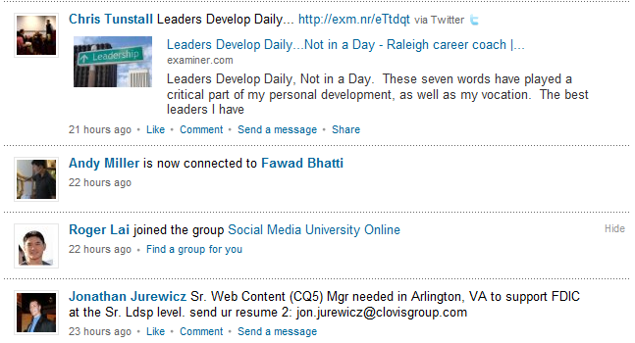
LinkedIn
If this were your LinkedIn account, you could…
See what groups your contacts are joining. “I might be interested in joining that.”
Read articles/opinions, posted by others, on business topics to help you stay “in the know.”
Find job posts. “I’m qualified!”
See who your contacts are connected to. “Hey, I know her.”

Slide 18
Top Ten Do’s and Don’ts
Do…
Create an online presence where you can showcase your skills and experience.
Be consistent. Does the employment history on your résumé match what's on your LinkedIn profile?
Google your name. There’s a ton of information an employer can find about you – better if you know it’s out there before they do.
Be careful of what you tweet/post. You don’t know who might read it.
Network before you need to. You’ll have a better chance of finding a job sooner and finding something you really want.
Give to Get. Networks work both ways. The more you’re willing to help someone out, the more help you’ll get in return.

Slide 19
Top Ten Do’s and Don’ts
Don’t…
Get Fired. Employers are checking Facebook, Twitter, and other sites. If you post it, someone at work will probably read it.
Forget your Facebook privacy settings. If you must post spring break photos, it’s always best to keep it hidden/restricted to certain groups.
Connect with everyone. Quality is better than quantity. Ask yourself two questions, “how can they help me?” and “how can I help them?”
Spend time networking at work. Companies can monitor your time on networking sites. It’s particularly ill-advised if you’re hunting for a new job.

Slide 20
How Do You Build a Network?
Understand who you know and who you need to know
Go to where
they are
Continue to
expand your
network
Meet people
and make
an impact

Slide 21
Network Map Example
Hobbies / Sports
Areas
of interest
Friends & Family
Location
Contacts
Parenting Groups
External
Personal
Your Company Personal
Department
Contacts
You
External
Your Company
Profess. Associa-tions
Current
Role
External Professional
Your Company Professional
Clients, Customer
Previous Role
Women’s Groups
Future Role

Slide 22
How To Greet Someone
Give a firm handshake
Make eye contact
Smile!
Don’t be silent; introduce yourself or at least say something like, “How are you?” or “Nice to meet you.”
How to Take a Business Card
Don’t immediately put it away; look over it first
Thank them and reciprocate by giving your own card
If you don’t have one, apologize and mention that you would still like to provide your contact details (have a pen and paper handy for this)

Slide 23
What is an Elevator Speech?
An Elevator Speech is a short introduction of yourself to be used in networking scenarios. The goal of the speech is to quickly and effectively introduce yourself including:
Who you are
Your interest
What you’re looking for/why you’re there
Your elevator speech should:
Be to the point (no longer than 25 to 30 seconds).
Flow and sound effortless.
Memorable and sincere – not overly rehearsed or robotic.
Practiced so you’re comfortable, but not memorized.
By writing and practicing an elevator speech ahead of time, it can help you manage nervousness, and ensures you can deliver an effective introduction.

Slide 24
Sample Elevator Speeches
Hi my name is Samantha Atcheson, and I am a senior Environmental Sciences major. I’m looking for a research and analysis position. Over the past few years, I’ve been strengthening these skills through my work with a local watershed council on conservation strategies to support water quality and habitats. Eventually, I’d like develop education programs on water conservation awareness. I read that your organization is involved in water quality projects. Can you tell me how someone with my experience may fit into your organization?
Nice to meet you, I’m Alex Harrison. I’m currently a senior and am studying Computer and Information Science. Upon graduation in May, I’m looking for a computer programmer position. I’ve had a couple of internships where I worked on several program applications with a project team. I enjoy developing computer applications for business solutions. The position you have listed in UO-JobLink seems like it would be a perfect fit for someone with my skills. I’d like to hear more about the type of project teams in your organization.

Slide 25
Creating an Elevator Speech
Write down all that comes up in your mind.
Cut the jargon and details.
Make strong, short and powerful sentences.
Eliminate unnecessary words.
Connect the phrases to each other.
Your elevator address has to flow natural and smoothly. Don't rush.
Know the key points and practice your talk.
Have you really answered the key question of your listener: What's in it for me?
Create different versions for different business situations of your elevator speech.
Practice, practice, practice.

Slide 26
Tips for Initiating Conversation
Set a goal that you will meet new people and not just stay with people you already know.
Do your prep work - know who is going to be at an event/meeting, if you can.
Position yourself in places where people tend to gravitate (e.g., food or bar areas, by windows).
Initiate a greeting (make eye contact, introduce yourself).
Find common ground.
Ask open ended questions (e.g., tell me what you are working on, what did you think of this morning’s session, what are you hoping to get out of this conference, etc.).
Listen more than you speak (apply active listening techniques).
Find opportunities to say the person’s name in the conversation so that you will remember it.
Bring business cards.
End conversations by planning for follow-up (if appropriate).

Slide 27
Tips During Conversation
Don’t interrupt the person speaking. If it is important to interrupt, you can interject with something like, “Sorry to interrupt you, but…..”
If three or more people are in discussion, be patient and look for opportunity to contribute to the discussion on a relevant point.
Don’t say anything negative about a past job experience or past professional affiliation.
If possible, ask questions to find out what challenges of the organization you’re interested in having. Every challenge presents an opportunity for you to show capability of adding value. Peak the interest of the network enough for them to agree to do a follow-up call.
“Name drop” when appropriate. If you have good references, don’t be afraid to use that in a networking environment.

Slide 28
Possible Conversation Starters
How long have you been with Company X?
Why did you join?
What keeps you at Company X?
How do you explain your job to your family?
What University did you go to and what did you study?
If you had to study anything else, what would it have been?
Favorite or most challenging project or experience at Company X?
What advice would you give to your younger self, professionally and/or personally?
What do you consider to be the most valuable aspects of your job: people, benefits or projects?
Why?
What does it take to be successful at Company X?

Slide 29
How to Introduce Others
Practice common courtesy: when someone new joins a conversation, pause the conversation to introduce that person to the others if you know them or introduce yourself
“Hi Becky; let me introduce you to Sam Waters and Patrick Smith (motioning towards each). Gentlemen, this is Becky Patterson.”
“Hello, I’m not sure we’ve met before (reaching out to shake hand). I’m Casey Bretl, and this is Sam Waters and Patrick Smith (motioning towards each).
If you have forgotten someone’s name, humble yourself:
“I am so sorry your name is escaping me at the moment. (Give opportunity to introduce themselves, then introduce others in the group if the person has not already initiated.) Right! How embarrassing. Becky, this is Sam Waters and Patrick Smith.”
Or, “This is Sam Waters and Patrick Smith. I am terrible out pronouncing names correctly. Can you save me the embarrassment?”
Or simply, “Have you two met?”
It is better to fess up than potentially botch the introduction by guessing

Slide 30
Networking Activity
Elevator Speech
Scenario: you are leaving a job fair, and you happen to catch the nametag of the person next to you at the coat check: it is one of the hiring managers at a company in which you are interested. You have 30 seconds to introduce yourself and make an impression!
Turn to the person next to you and introduce yourself and why you should be hired for the job they have open
Ask the other person for feedback on improvements or changes, then switch roles

Slide 31
Navigating Job Fairs
Prepare in advance:
Identify firms and jobs that interest you (and apply in advance)
Find out more about the company (beyond their website)
Bring plenty of business cards and resumes (and something to file away business cards and brochures received)
Be your best self: dress as you would for a job interview, smile, and be full of energy
Practice your Elevator Speech!
Be polite and patient
Take notes
Follow-up immediately

Slide 32
Wrap Up
Any Questions?
Harold Washington Career Planning & Placement Office
Room 1140
(312) 553-3000
Monday-Thursday: 9:00 a.m. - 5:00 p.m. Friday: Closed Appointments: Monday - Thursday 9:30 a.m. - 11:30 a.m. & 2:00 p.m. - 4:00 p.m.

